Slide 1
Navy Manpower Analysis Center (NAVMAC)
Command Overview
NAVMAC at a Glance
CAPT M. Juanique Wallace CAPT Shaletha R. Moran Mr. Doyle Avant
Commanding Officer Executive Officer Technical Director

Slide 2
NAVMAC Executive Overview
Discuss:
  Mission Areas, Scope, and Major Outcomes
  Structure and Workforce
Discuss:
  Operational Strategy, Key Accomplishments, and Significant Initiatives
Illustrate Navy’s Manpower Requirements Determination Process
Transformation
S2025
Enterprise
Support
Force
Development
Force
Management

Slide 3
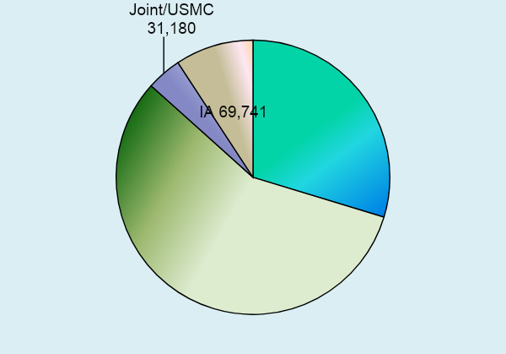
NAVMAC
Mission Areas and Scope
Navy’s Occupational Classification Systems (NOCS)
  Comprehensive Job & Qualifications Management
    Military Classification Structures (e.g., Rating, NEC, Designator, AQD, NOBC, SUBSPEC)
Manpower Requirements Determination
  Fleet Manpower Requirements Determination (FMRD)
  Shore Manpower Requirements Determination (SMRD)¹
Navy’s Manpower Management Program Administration
  Effective Manpower Programs and Policies
    Supports Activity Manpower Management (AMM) for 779,351 manpower requirements
Navy’s Manpower Information System Business Requirements
  Effective Information System (IS) Performance
    Supports manpower functionality for stakeholders and users
Navy Manpower Training¹
  Staff focus near-term – Manpower users
  External customers downstream
779,351 Manpower Requirements
As of end of Sep 2023
    678+K or 87% of Navy’s Manpower Requirements
1 Launched July 2021

Slide 4
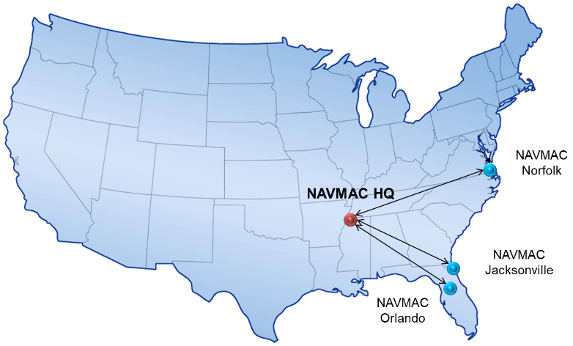
Structure and Workforce
Technical Director
Commanding Officer
Business Systems Analysis Office
Code 60
Executive Officer
Manpower Training Office
Code 80
Admin Office
Established FY21
Workforce Classifications
Code 10
Manpower Programs
Code 20
Aviation Programs
Code 30
Afloat
Programs
Code 40
Manpower Analytics
Code 50
Shore Programs
Code 70
Code 10
Orlando, FL
Established FY23
NAVMAC Reserve Unit
NAVMAC Detachment
Jacksonville, FL
Senior Analytical Staff
  Manpower Analysis
  Industrial Engineering
  Organizational Psychology
  Recent Fleet Experience
  Operations Analysis/Research
  Human Resources
  Warfare Specialties
NAVMAC Detachment
Norfolk, VA

Slide 5
Dissecting NAVMAC’s Work
Code 10
Defines Navy’s work into a workforce structure
Occupational Standards
Naval Standards
Navy Officer & Enlisted Occupation Classification System (NOOCS & NEOCS)
Code 20
Manages manpower programs and policies
Develops & maintains manpower policy
Maintains FMRD/SMRD Allowances, Factors, Standards, and Modifiers (AFS&Ms)
Special Studies & Consulting
Code 30
Develops manpower requirements for the aviation enterprise
Squadron Manpower Documents and Manpower Requirements Worksheet
Aviation Fleet Manpower Documents (AFMD)
Support to Aviation acquisition
Code 40
Develops manpower requirements for afloat programs
Ships, Submarines, & expeditionary/deployable staffs
Support to Fleet acquisitions
Code 50
Provides analytics for manpower management & command production
Analytics and modeling support
Visualization for decision makers
Implement efficient data handling
Code 60 / BSAO
Manages functionality and reliability of Manpower Information Systems
Validate manpower business process and IS procedures
IS governance & data reliability
Code 70
Develops manpower requirements for Shore organizations
Determine manpower requirements for peacetime and mobilization operations
Code 80 / MMTO
Delivers manpower training
Provides technical & professional training
Manages the GMT program &
Employee onboarding
Primary customer facing lines of effort
…all customer-facing lines of effort touch each department…

Slide 6
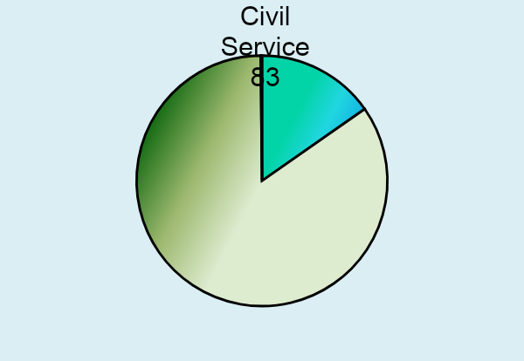
Discussing NAVMAC’s Work
Code 10
Defines Navy’s work into a workforce structure
Administers NEOCS/NOOCS programs
~4,600 individual products touch 100% of the Navy’s manpower requirements and personnel
  Designators, AQDs, SUBSPECs, Occupational/Naval Standards, and NECs
Significant initiatives
  Robotics Rating Development
  Cyber forces classification standards
Manages manpower programs
  Develops and implements policies governing manpower business processes and data
Conducts special studies & provides consulting
Administers analytics agenda program
Governs appropriateness of AFS&Ms for FMRD/SMRD
Significant Initiatives
  Shore PF&D Allowance
  OPNAVINST 1000.16M
  New MFT instruction – Expanding to improve identification of command work and products
Code 20
Manages manpower programs and policies
Administers Aviation FMRD program – Conducts FMRD studies and produces:
  Squadron Manpower Documents (SQMD)
  Manpower Requirements Worksheet (MRW)
  Aviation Fleet Manpower Documents
  Analysis underwriting Navy acquisition programs
    Examination of PSQMDs
Universe contains 53,542 manpower requirements
Significant Initiatives
  FY2024 production plan
  Aviation staffing standards
  Building aviation-centric business rules for FMRD model development
Code 30
Develops manpower requirements for the aviation enterprise
53,407 Manpower Requirements
As of end of Sep 2023

Slide 7
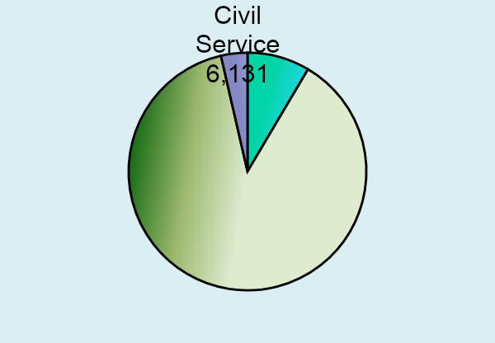
Discussing NAVMAC’s Work
Administers Fleet FMRD program - Conducts FMRD studies and produces:
  Ship Manpower Documents (SMD)
  Fleet Manpower Documents (FMD)
  Analysis underwriting Navy acquisition programs
    Investigations of PSMD/PFMD
Universe covers 171,601 manpower requirements
Significant Initiatives
  FY2024 production plan
  RCOH MRD study
  Building ship/fleet-centric business rules for FMRD model development
Code 40
Develops manpower requirements for afloat programs
170,834 Manpower Requirements
As of end of Sep 2023
Administer production metrics for all NAVMAC products
Administers command Continuous Process Improvement (CPI) program
  Delivers process control solutions
  Improve production goals, cycle time, etc.
Delivers automation solutions
  Reduces manual actions and eliminate non-value added steps
Significant initiatives
  Expanding production metrics
  Building CPI program
  Analytically assessing FMRD/SMRD modeling efforts
Code 50
Provides analytics for manpower management & command production
Code 60
Manages functionality and reliability of Manpower Information System
Provides business systems analysis for manpower information systems
Documents user requirements
Develops functional requirements
Maintain integrity of and access to information systems
Significant initiatives
  Leading FMRD/SMRD modeling activities
  Managing legacy information systems

Slide 8
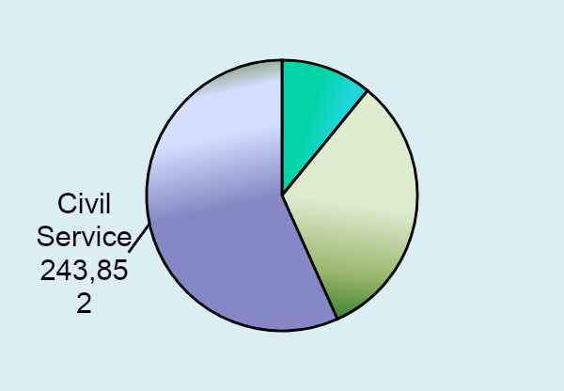
Discussing NAVMAC’s Work
Administers Fleet FMRD program - Conducts SMRD studies and produces:
  Shore Manpower Documents (ShMD)
  Manpower Estimates
Universe covers 453,287 manpower requirements
Significant Initiatives
  FY2024 production plan
  Pay and Personnel Program
  CYBER Workforce
  Building SMRD-centric business rules for FMRD model development
Code 70
Develops manpower requirements for Shore organizations
430,041 Manpower Requirements
As of end of Sep 2023
Administers command’s knowledge management programs
Develop, maintain, and deliver training for command lines of business
Administers command on-boarding and personnel indoctrination training
Significant Initiatives
  Initial focus on edifying NAVMAC staff – improving staff credentials
  Strengthening training content
  Acquiring authenticity/recognition of training program from NETC
  Expanding student participation outside NAVMAC
Code 80
Delivers manpower training

Slide 9
NAVMAC
Command Strategy and Key Accomplishments
Three-pronged Strategy
Key Accomplishments
Modernize Business Processes
Increase availability, accuracy, and agility
  Employ cutting-edge analytics and modeling
    Fleet Manpower Requirements Determination (FMRD)
    Shore Manpower requirements Determination (SMRD)
  Event-based Occupational Classifications
Centralized SMRD Program - Decentralized since 1986
  Decentralization and funded directed by VCNO
  Launched centralized program on 18 July 2021
  Integrated manpower teams from USFF, BUMED, and CNIC
Enhanced FMRD processes
  Deployed updates to accommodate GAO Recommendations, RROC directives, and NDAA19 legislation to:
    Implemented new Afloat Navy Availability Factor (NAF)
    Added inport work to surface ship manpower requirements determination studies
    Update AFS&Ms that adjust workhours to account for real-world operations
Modernized Manpower Information Systems (IS)
  Total Force Manpower Management System (TFMMS)
    Expanded business rules and system control edits to improve fidelity and integrity of manpower data
  Defined business needs of manpower customers and delivered Functional Requirements (FR) to support IS applications development
Modernized Navy Occupational Classification processes
  Increased throughput through deployment of “virtual” sailor-centric SME panels to define rating work and tasks
  Delivered enhanced Navy Enlisted Code (NEC) construct to better define specialized skill needs
Improve Manpower Processes
Challenge Assumptions
Update Allowances, Factors, Standards and Modifiers (AFS&M) that adjust workhours
Develop New Data Collection & Computation Methods
Continued refinement of data collection protocols
Deployed policy requiring regular review
Leverage All Available Resources
Navy Analytic Office (NAO)
  Annual Study Submissions
Survey & Database Capabilities
  e.g., NETC Job Task Analysis
Organic, Navy, and Private Sector expertise
  Ship Sailors
  Business Analysts / Information Professionals
  Industrial Engineers
  Operations Analysts/researchers
  Industrial/Organizational Psychologists
‹#›
Notes:
Our efforts to modernize manpower business started long before the dawn of MyNavy HR transformation.
We continue to follow a three pronged strategy that begins by improving Activity Manpower Management, improving & expanding FMRD Modeling and deploying enhanced Occupational Classification business models and support systems.
Our second focus is on improving overall manpower processes – We are:
Challenging age-old assumptions
Updating AFS&Ms which are the time adjustments that the FMRD model uses to account for operational items that are outside Sailor control (give examples)
Building new data collection and computational methods. We are tracking to leverage the ADE and AaaS to streamline data collection and rapidly implement changes to the FMRD Model
Finally, we are leveraging all available external resources to help us modernize manpower business and improve our processes.
As an example, we successfully completed a NAO-funded Operational Afloat Workweek (OAW) study in 2018 that resulted to changes in the NAF reflected in the 1000.16
We expect a July 19 start of an Afloat Facilities Maintenance study to get at how the FMRD Model calculates ~6-7% of the SMDs at-sea workhours.
From an Accomplishment Perspective
First and foremost we meet our FMRD and OCCSTDs production schedules, which N12 approve following Fleet concurrence
We implemented significant enhancements, which allowed Navy to fulfill GAO recommendations and comply with RROC and NDAA 2019 mandates.
In Jan 2019, CNP approved a new NAF which implemented a 67 hours/week.
The new NAF/PAF is increasing warfighting manpower RQMTs and for the first time accounts for individual sailor training – Again Challenging old Assumptions
No longer is FMRD a wartime-only program. It now has an operational focus through the integration of at-sea and inport work into a total Sailor work SMD protocol – For the 1st time
Finally we implemented policy and launched production schedules to update the FMRD Model’s AFM&S to ensure they reflect fleet realities
A major milestone was the deployment of TFMMS 2.0 which delivered a modern architecture and significant improvements to AMM and we developed the first comprehensive set of functional requirements for FMRD protocols and Occupational Classification business requirements
Finally, we made significant improvements to how we classify work and military personnel that leverage military SMEs, delivered new NJA protocols and implemented a new NEC construct.

Slide 10
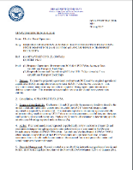
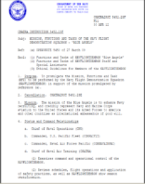


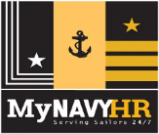

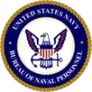


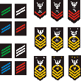
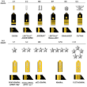

Manpower Requirements Determination
Measuring Work & Defining Manpower Requirements
Higher Headquarters Controls (Title 10 & DOD, SECNAV, OPNAV Instructions)
Inputs
Primary Workload Drivers
MRD
RS/BSO Manpower Authorizations
Mission
Considerations
Capabilities
Roles
Configuration
Layout
Policies
Define Workload
Manpower
Study Reports
TFMMS
Navy’s authoritative Manpower RQMTs & AUTHs
Calculate Workhours
ROC/POE
Activity
Manpower Document (AMD)
Apply Manpower Standards/Models
Allowances, Factors, Standards,& Modifiers
Approval
Final
Output
Manpower
Requirements
MFT
BSOs publish MFTs
RS publish ROC/POEs
Apply Occupational
Skills
Special
Projects
Study
Prep
Review historical data
Schedule on-sites
Prepare data tools
etc.
Model
Calculate & Optimize
Distribute Work Organizationally
Collect Workload Data
Watches
Functions/Tasks
Production Plans
Performance Metrics
Overhead
Maintenance
  Where applicable
Directed – policy/instruction
On-site
Virtual
IT Interfaces
Draft Manpower Documents
Stakeholder
Review, Reclama, & Adjudication
Recruiting
Distribution
Federal Civil Service Career Management
Review & Reclama
NAVMAC
Functionality
Military Community Management
Training
Changing any of the inputs will change the output

Slide 11
Questions

